Slide 1
SC1015 DS and AI
SC5 Group 1
Ng Tze Kean (U2121193J)
Phee Kian Ann (U2122217L)
Ong Hai Xiang (U2121068F)
Notes:
Greeting Professor and friends, we are Group 1 SC5, our mini project is on car resale price

Slide 2
Table of contents
Motivation for project
Problem definition
Data cleaning and feature engineering
Machine learning
Lessons learnt and outcome
Notes:
This will be the table of contents for our presentation

Slide 3
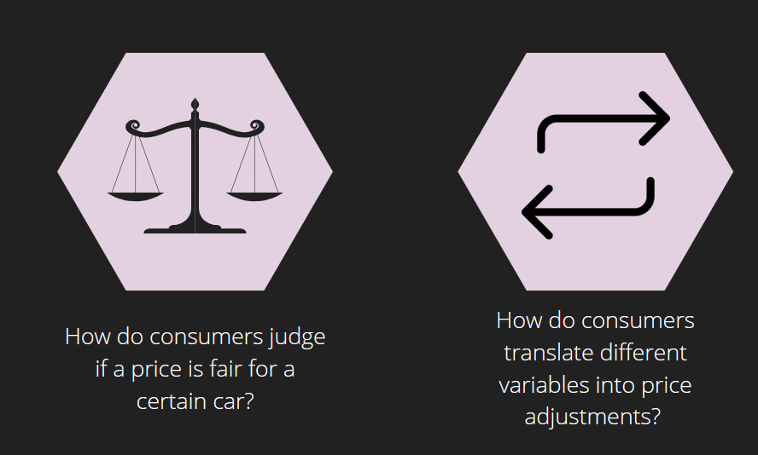
Project Motivation
Notes:
We have identified 2 key project motivation from real world problems. When looking at car listings, firstly, how do consumers judge if a price is fair for a certain car? Secondly, when looking deeper into the statistics of a car, how should consumers translate different price variables and adjust their prices accordingly?

Slide 4
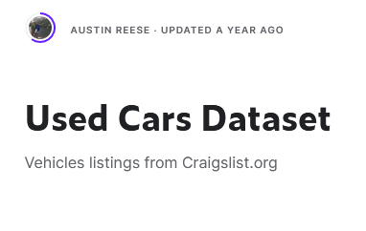
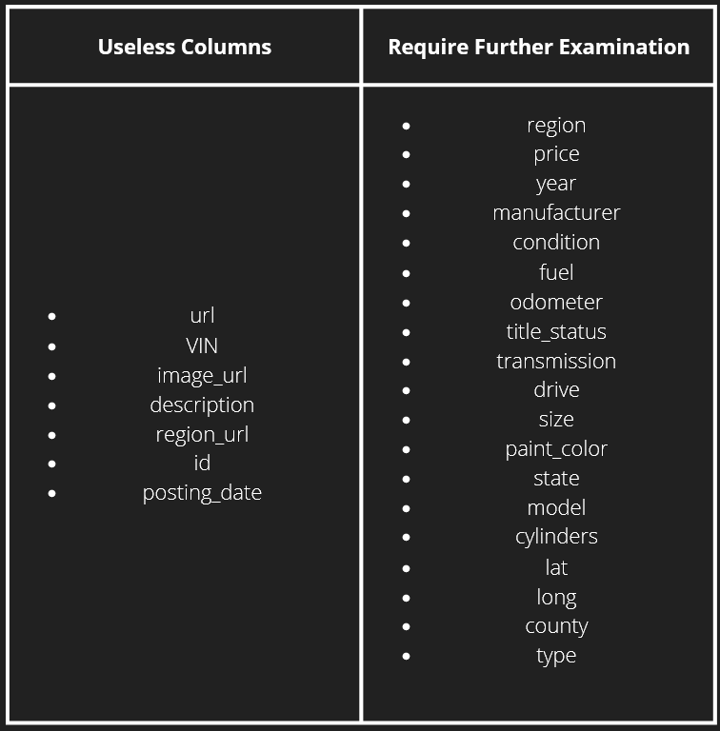
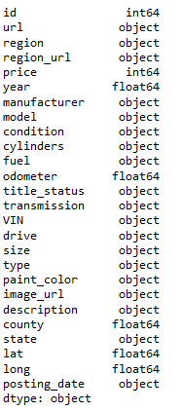
Dataset
Collection of all used car listings in Craigslist US
Periodically updated every few months with a web scraper
Used Cars Dataset
www.kaggle.com/datasets/austinreese/craigslist-carstrucks-data
Size of Dataset
Columns
426880
26
Notes:
We used the used cars dataset from kaggle, which periodically scrapes craigslist US for used car listings. Basic EDA tells us that there are 426k listings, with 26 columns. However, some of the columns are immediately useless, since they hold no important information that can be further analysed, a quick summary is shown here.

Slide 5
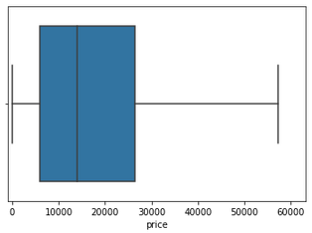
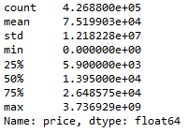
Price
Big difference between mean and median
Suggests the presence of large outliers
Further supported by min and max values
Notes:
Price is the dependant variable that we would like predict, so we have done further EDA on it. one can see that there is a clear difference between the mean and median. This suggests the presence of extreme outliers which can sway the mean price, and further data cleaning will be required to remove these outliers.

Slide 6
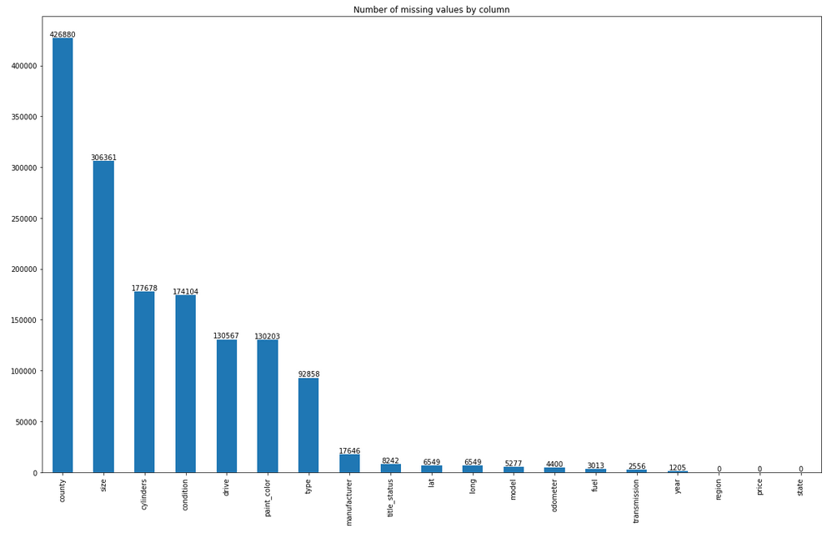
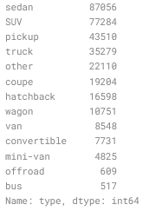
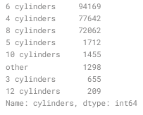

Choosing Columns to Ignore
County | Significant amount of missing values
Model | Too many unique values to do anything useful
Lat | Low correlation
Long | Low correlation
Cylinders | “Other” value significant
Type | “Other” value significant
Paint_color | Hard to determine exact shade of color
Notes:
After carrying out further EDA, we have chosen to ignore these columns as well. To name a few, county column had too many missing values, and there are too many unique values for the model column to do anything useful.
After plotting a correlation matrix for the numerical variables for listings of the top 6 manufacturers, we found that latitude and longitude had low correlation with price across the board, and we have decided to ignore it.

Slide 7
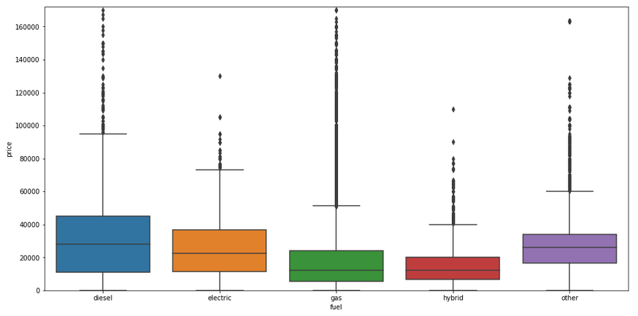
Fuel vs Price
Some correlation between type of fuel and car price
Diesel cars are more expensive
Better technology to accommodate more pressure
How does the fuel type affect the resale value of a car?
Notes:
By plotting a boxplot of the different types of fuel against price, one can see that there is some correlation between the type of fuel and car price. Fuel type is probably an important variable in predicting price.

Slide 8
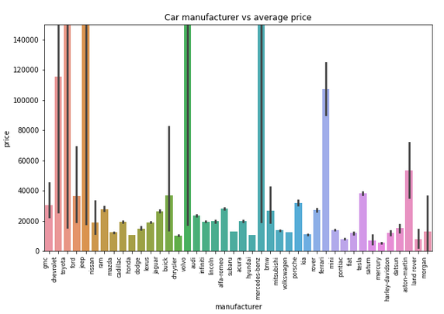
Price vs manufacturer
Some correlation between manufacturer and car price
Luxury brands vs budget brands
How does the manufacturer affect the resale value of a car?
Notes:
One useful variable to consider is the manufacturer. when seeing the average price across different manufacturers, one can see the huge disparity between different brands. This is because brands like mercedes-benz produce expensive luxury cars, while brands like mitsubishi produce cheaper economical cars. Hence, how does the manufacturer brand affect a car’s resale value?

Slide 9
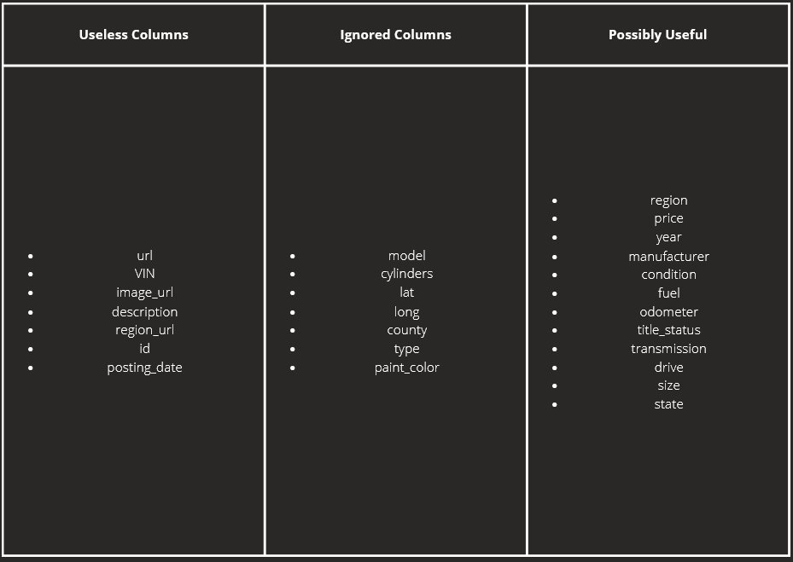
Notes:
Repeating this thought process across different columns allows us to identify which columns are useful for price prediction and which are not. A summary is shown here.

Slide 10
Problem definition
How different variables such as [odometer, year, condition, fuel, title_status, transmission, drive, state, manufacturer] affect the resale price of a car.
1
2
3
How do different models
(Tree regressor, linear regression,
tree classifier) respond to the variables
Does applying feature engineering to the dataset change the way the model responds to the dataset?
Is there a better model (XGBoost) we can use to better predict the price of the car?
Notes:
Our problem definition is shown on the slide and we have split it into 3 sub problems, which we will solve to help us achieve a final solution

Slide 11
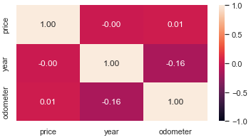
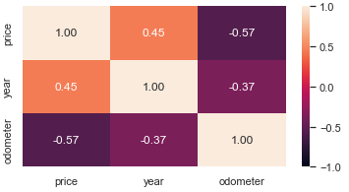
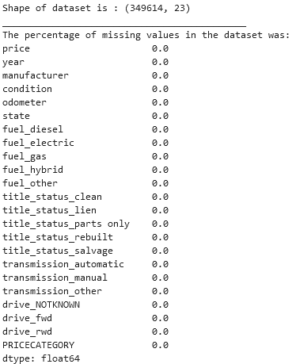
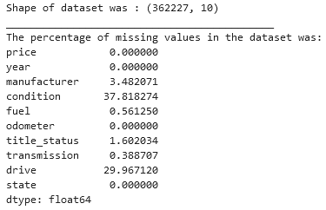

Data cleaning and feature engineering
Notes:
With the problem statement defined we proceeded to clean the data to train our machine models. Overall we have raised the correlation of numeric variables and we have applied feature engineering techniques to improve efficacy of our trained model

Slide 12
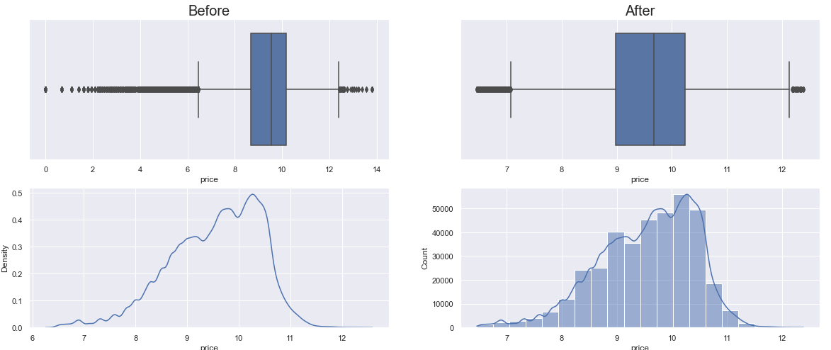
Data cleaning and feature engineering
Outlier handling
Whiskers of boxplot to determine outliers
Notes:
We first tackled outliers that were outside of the whiskers of the box plots

Slide 13
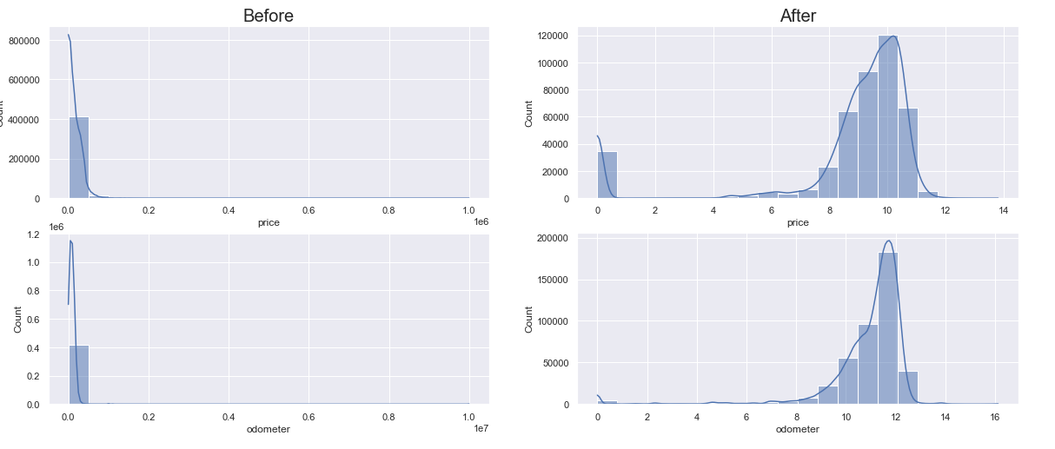
Data cleaning and feature engineering
Transformation of skewed data
logarithmic transformation
Notes:
We had variables such as price and odometer which were right skewed, so we tired performing a lo-ga-rith-mic transformation to give it a more symmetric distribution.

Slide 14
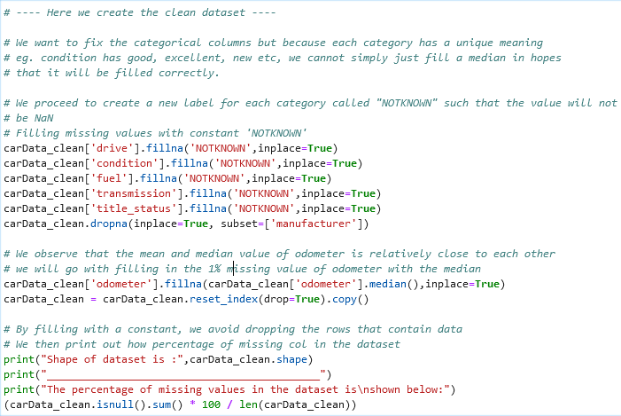
Data cleaning and feature engineering
Imputation
handling missing values in data
Notes:
We also applied imputation technique as we found that there were over 30% of missing data in some of the variables which did not give a strong enough justification to drop from our dataset. For numeric variables, we imputed the median. For categorical we imputed a “notknown” category

Slide 15
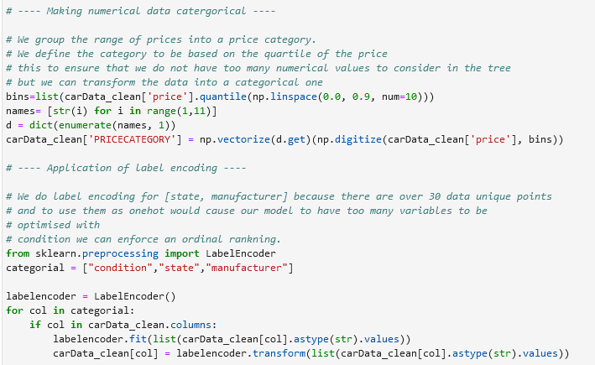
Data cleaning and feature engineering
Discretization
taking a set of values of data and grouping sets of them together in some logical fashion into bins
Notes:
A new feature engineering technique we applied that was not taught in lectures was to use dis-cre-ti-zation, where we group the numeric variable, price, into larger bins. We reduced the precision of price prediction, but since our problem definition was to explore how the variables affect the resale price and NOT to predict a resale price, we are able to reduce the number of nodes generated by the model during the machine learning phase.

Slide 16
Subproblem 1:
How do different models
(Tree regressor, linear regression,
tree classifier) respond to the variables
Subproblem 2:
Does applying feature engineering to the dataset change the way the model responds to the dataset?
Notes:
We will now delve into the core analysis of our project. Here we discuss the 2 subproblems we tried to solve with machine learning. We will be going through tree regressor, linear regression followed by tree classifier and we will analyse how discretization changed the way the model responded.

Slide 17
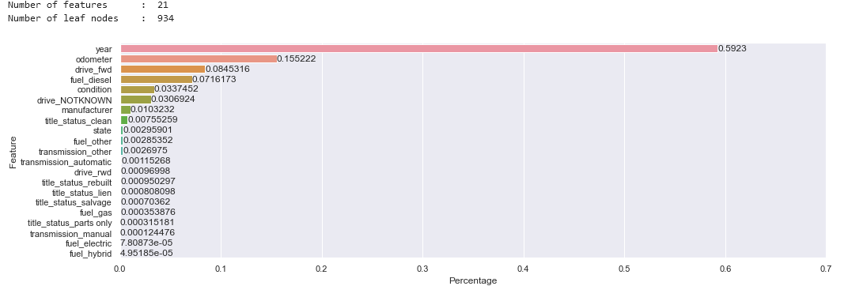

Model fitting (Tree regressor)
vs
Notes:
The format moving forward will be such that images on the left of slide is the model fitted with price as numeric, and on right would be price as categorical, range 1 to 10.
We see that evidently, changing the response variable does not change the feature importance for tree regressor.

Slide 18
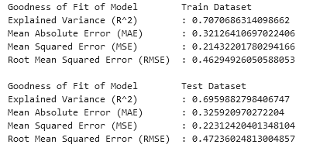
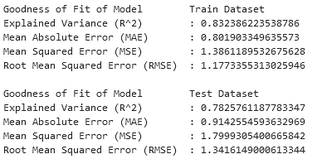
Model fitting (Tree regressor)
vs
Notes:
What is interesting is that the model returned significantly higher explained variance, indicating a better fit! Do note that since the response variable is different, so we cannot directly compare other statistics such as MSE here.

Slide 19
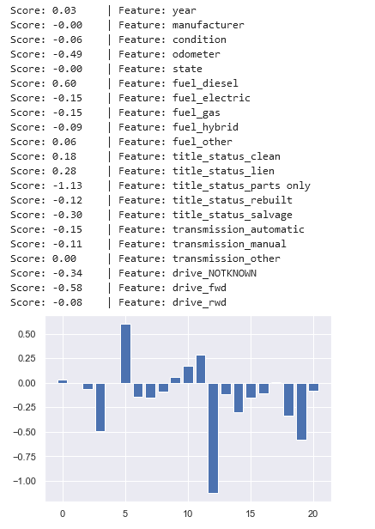
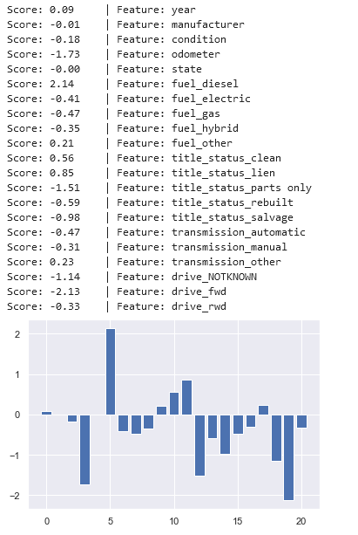
Model fitting (Linear regression)
vs
Notes:
We also noted that the feature importance for linear regression model did change when using a different response variable, where some variables such as if a car is using diesel or not could play a higher importance in predicting price of car.

Slide 20
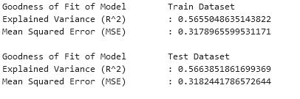
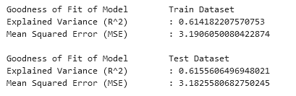
Model fitting (Linear regression)
vs
Notes:
Overall, we see that the explained variance for price as categorical resulted in a better fit on both test and train set for linear regession

Slide 21
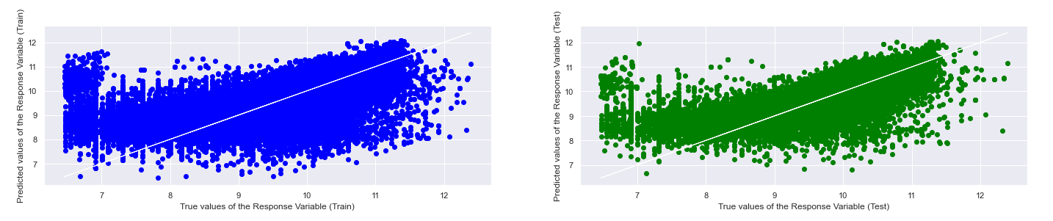
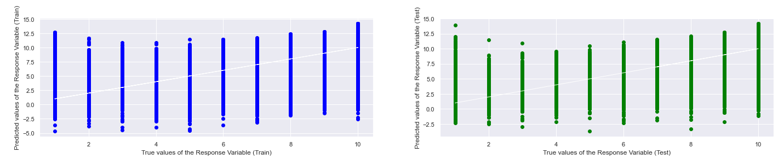
Model fitting (Linear regression)
Notes:
But we note the negative prediction returned by the linear regression model, suggesting that linear regression might not be a good model to use for prediction of resale price of the car (since I can't possibly be paying money to someone im selling my car to)

Slide 22
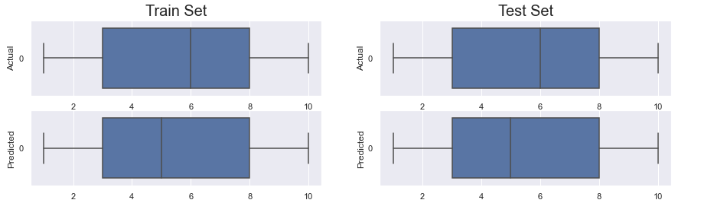
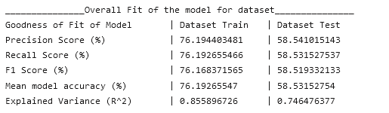
Model fitting (Classifier)
Notes:
Lastly, l since we are using price as a categorical variable, we assess tree classifier mode. And we can see that the model performs poorly for the test set.

Slide 23
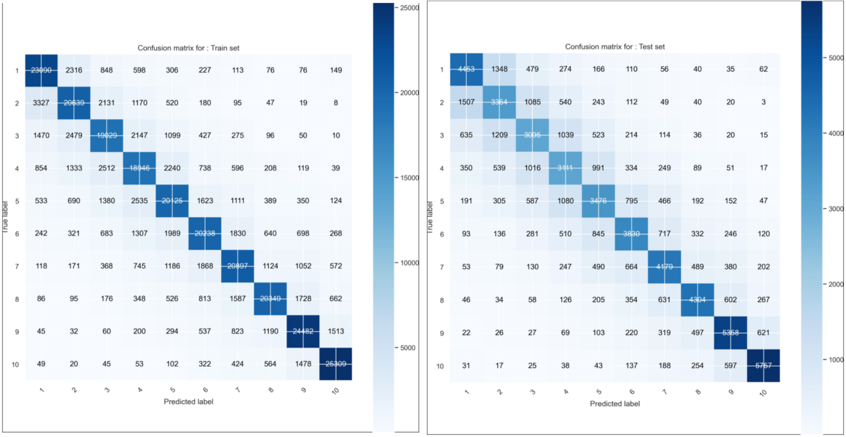
Model fitting (Classifier)
Notes:
confusion matrix on the right also shows how much better the model could perform for the test set

Slide 24
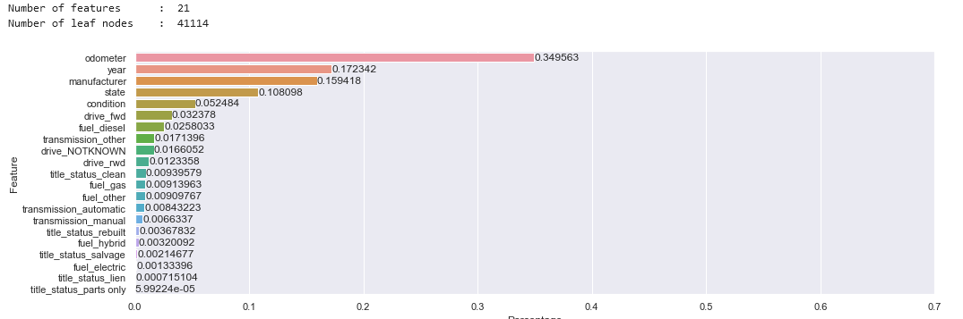
Model fitting (Classifier)
Classifier
Tree regressor
Notes:
We did also realised that the classifier model placed a different percentage of feature importance compared to its regressor counterpart.
For the classifier, year only has 17% significance while year has 56% significance in the regressor.

Slide 25
Takeaways from Subproblem 1 & 2
Different models have variables with different feature importance allocated. Indicating that optimal set of variables to best predict price differs for each model
Using price as categorical gave a better model fit for regressors
Classifier more suited for predicting price when it is categorical, but F1 score obtain is low, so a better model can be explored
Notes:
To summarise the takeaways for subproblem 1 and 2
Different models have variables with different feature importance allocated.
Using price as categorical gave a better model fit compared to price as numeric, this was to be expected since having larger bins means smaller Residual sum of square, which implies larger R^2
Overall, Classifier more suited for predicting price when it is categorical, but F1 score obtain is low, so a better model can be explored

Slide 26
Subproblem 3:
Is there a better model we can use to better predict the price of the car?
🡲 eXtreme Gradient Boosting
Notes:
Now onto subproblem 3: Is there a better model we can use to better predict the price of the car?
We have learnt that decision trees are greedy and deterministic, and thus there is a tendency for overfitting of train data such that the performance of the tree on train data is bad. Thus, we are trying out a more complex model such as XGBoost to try and predict the data instead.

Slide 27
eXtreme Gradient Boosting
(XGBoost)

Slide 28
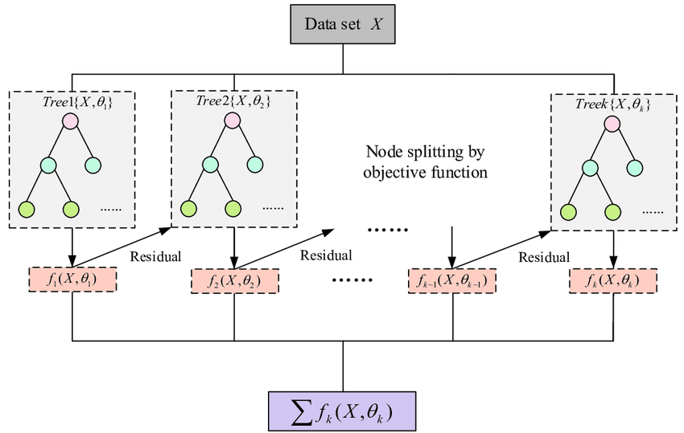
XGBoost
Iterative procedure built using ensemble decision tree methods
That builds a sequence of initially weak models into increasingly more powerful models
Using the gradient descent architecture
Notes:
XGBoost is an iterative procedure built using ensemble decision tree methods that build a sequence of initially weak models and combine them into increasingly more powerful models using a gradient descent architecture.

Slide 29
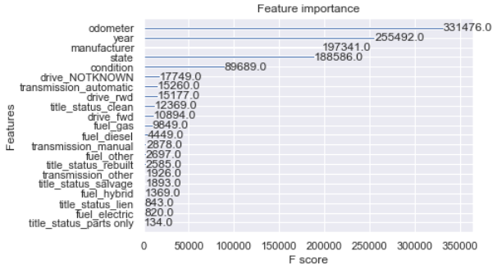
XGB Regressor (Tree depth 1 - 25)
Prediction of categorial prices using regression
Gradient Boosting rounds = 25
Cross Validation of nfold = 5
Evaluation Metric : RMSE
Notes:
###First Draft with Regressor
First, we used the XGB Regressor to create a model based on squared error as the objective. We tuned the hyperparameters to ensure efficient speed and good prediction accuracy.
We ran our model through tree depths of 1 to 25 to see what kind of difference a deeper tree would make.
Also, we have made sure to also do cross validation of 5 folds at every depth.
We can see that the XGB Regressor model places a large significance on the odometer instead, which is a stark contrast to the significance of the year in the decision tree model.

Slide 30
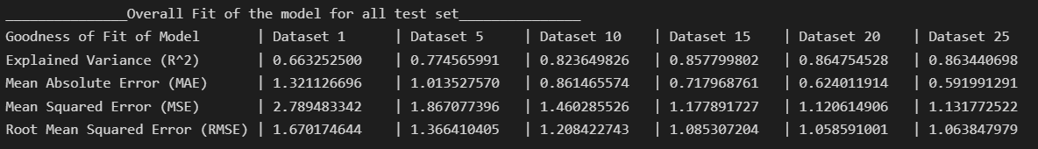
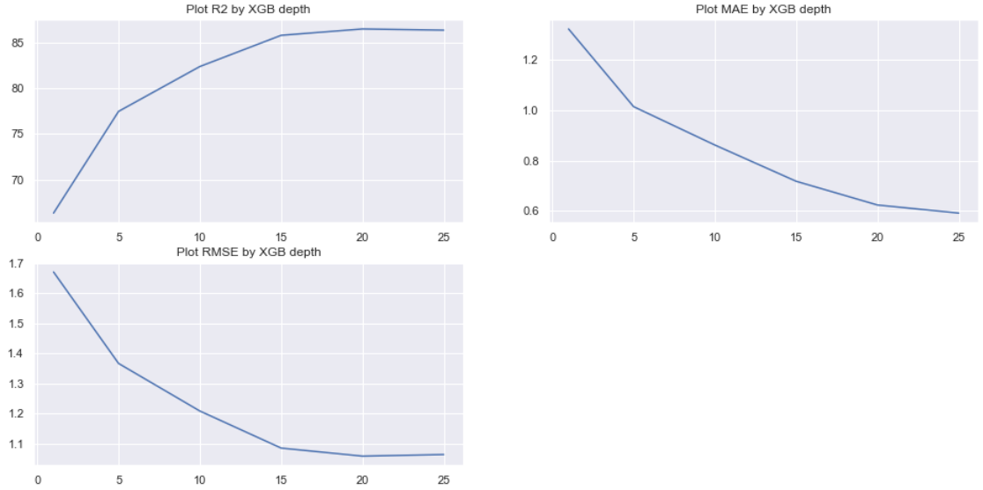
XGB Regressor (Tree depth 1 - 25)
Notes:
####### Hide for time sake
Plotting out the evaluation matrix for the model, we see that the gains at the cost of performance for overall model fit starts diminishing after depth of 15, where we see the highest r^2 value of 0.86. We can also see the mean errors, MAE & RMSE having a downward trend as the depths increase.

Slide 31
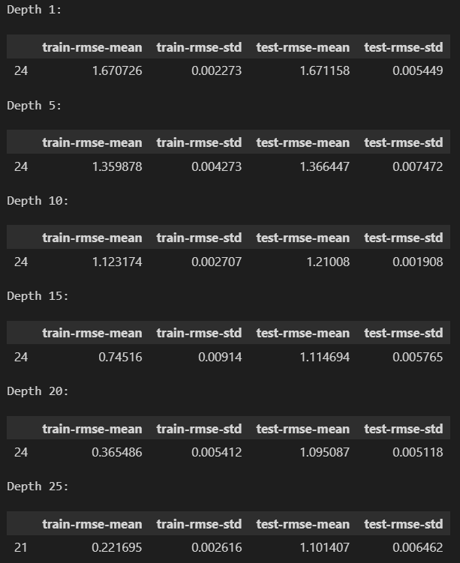
XGB Regressor Cross-Validation
For all depths
Standard Deviation : 0.001 - 0.009
Depth 25
Train folds RMSE : 0.221695
Test folds RMSE : 1.101407
Notes:
###First Draft with Regressor
For every depth, we can see that the cross validation metrics seem to indicate that our model is consistent for every set, as the standard deviation is very low, in the 3 decimal place range, and the root mean squared error for both test and train is around 1.1 or less at depth 25.

Slide 32
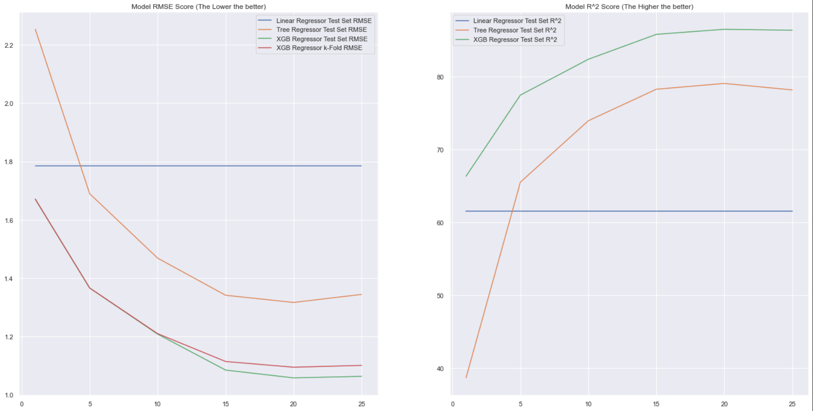



XGB Regressor VS Decision Tree Regressor
Notes:
###First Draft with Regressor
Through the graph, we can easily visualize the fact that the XGB Regressor outperforms both models at every depth, with lower RMSE and higher R^2 value

Slide 33
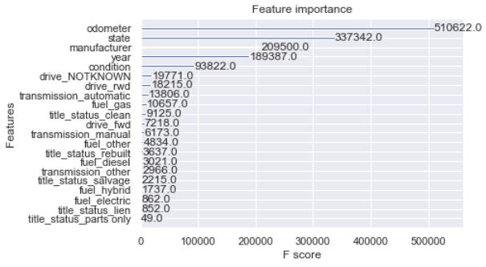
XGB Classifier (Tree depth 1 - 25)
Prediction of categorial prices using classification
Gradient Boosting rounds = 25
Cross Validation of nfold = 5
Evaluation Metric : Log Loss
Notes:
For XGBoost, we have done both both XGB Regressor and Classifier models, but we will focus on the Classifier for this presentation, we used the XGB Classifier to create a model evaluated based on the loss function: log loss.
We tuned the hyperparameters to ensure efficient speed and good prediction accuracy.
and ran our model through tree depths of 1 to 25 to see what kind of difference a deeper tree would make.
Also, we have made sure to also do cross validation of 5 folds at every depth.
We can see that the XGB Classifier model places a large significance on the odometer instead, which is a stark contrast to the significance of the year in the decision tree model.

Slide 34
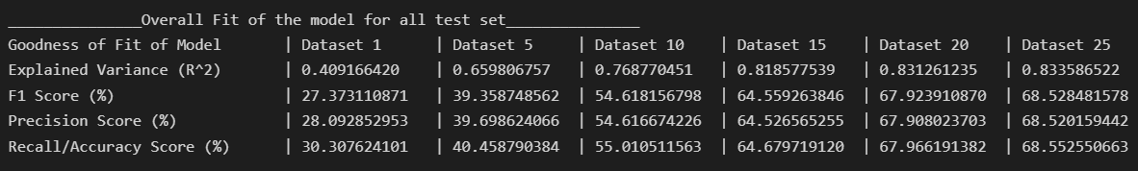
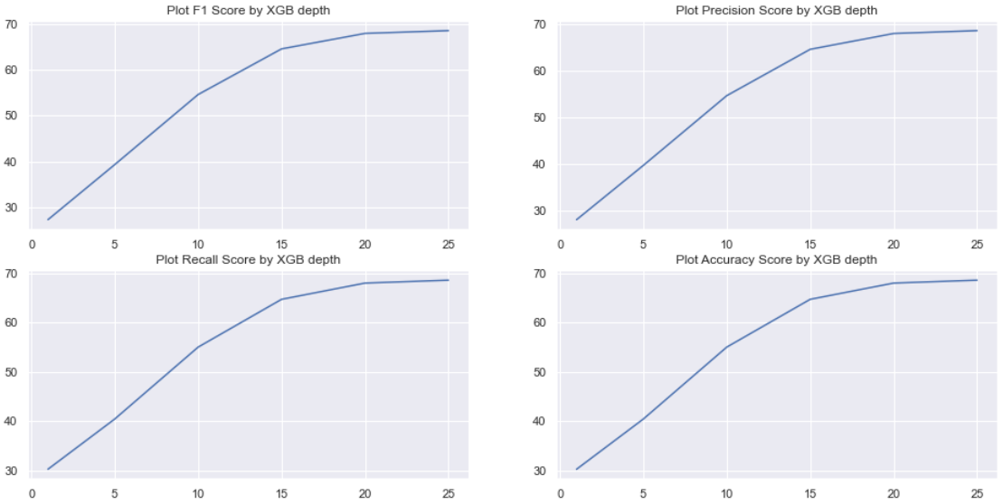
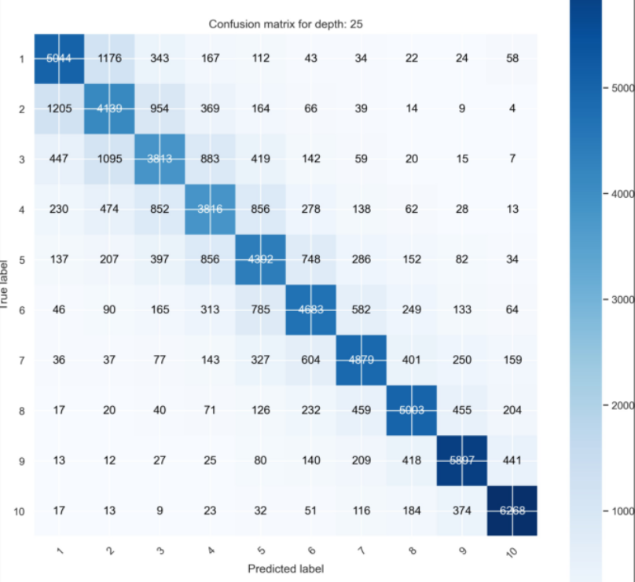
XGB Classifier (Tree depth 1 - 25)
Notes:
Plotting out the evaluation metrics for the model, we see that the gains at the cost of performance for overall model fit starts diminishing after depth of 15,
The F1 score, which is a general score used for classification metrics, can be seen increasing with the tree depth and peaks at 68% at depth of 25. The rest of the scores see similar results.
The confusion matrix can be seen to provide a good amount of true positives and negatives for depth 25, which reflects the F1-score of 68%.

Slide 35
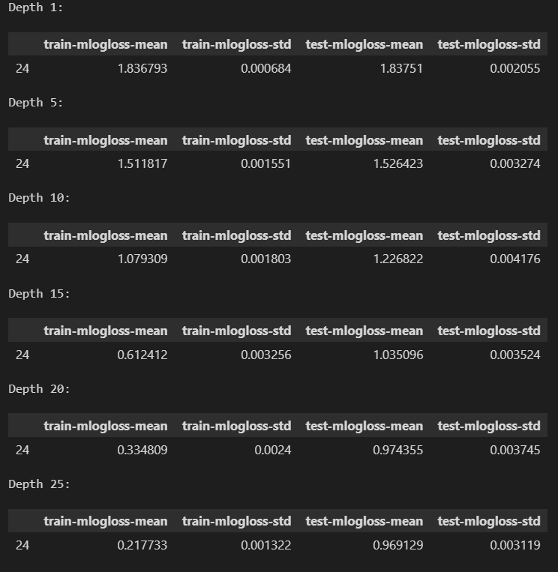
XGB Classifier Cross-Validation
For all depths
Standard Deviation : 0.0006 - 0.004
Depth 25
Train folds Log Loss: 0.217753
Test folds Log Loss: 0.969129
Notes:
###Shortened
For every depth, we can see that the cross validation metrics seem to indicate that our model is consistent for all depths, as the standard deviation is very low, in the 3 decimal place range, and log loss for both test and train is around 1 or less at depth 25.
###First Draft with Regressor
Like the regressor, log loss is low and standard deviation is also low between each fold for all depths, indicating consistency.

Slide 36
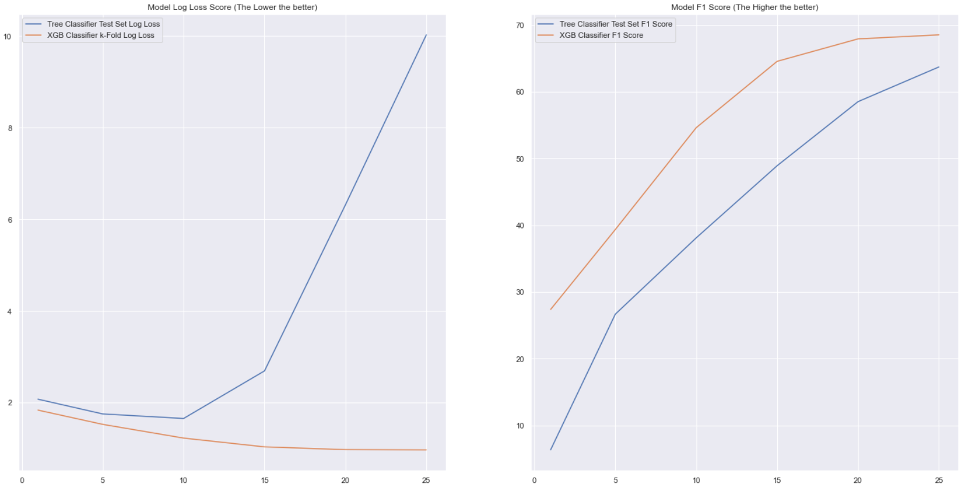


XGB Classifier VS Decision Tree Classifier
Notes:
###First Draft with Regressor (No change)
Now comparing the two models, we can see the Tree classifier has a very bad log loss score as it starts to shoot up after depth 10, which means the predicted results become increasingly further than the actual. XGBClassifier generally performs better than Tree Classifier in all depths.

Slide 37
Outcome of the project
- Through solving each subproblem, we have shown how these predictors and response variables are correlated and how different models can affect the accuracy of the prediction. In general, we find that a more complex model, while more computationally costly, can give us better results for the same set of variables compared to a simple model.
- [odometer, state, year, manufacturer] remains as the few variables with high feature importance throughout the different models 🡲 strong predictors for resale price
- Lower odometer 🡲 higher resale price
- XGboost model allow a seller to price his car competitively or for buyer to not be scammed
Notes:
Moving on to the outcome of the project,
By solving each subproblem, we can drive an answer for our main problem identified at the start of the video. And we found that the various predictors and response variables are correlated, and different model for the same set of variables gave different predictions. In general, we find that a more complex model, while more computationally costly, can give us better results for the same set of variables compared to a simple model.
Next, there are certain variables like odometer which are consistently the top few most important feature in predicting resale price of car, indicating that these variables should be included in future models used.
Lastly, we have shown that xgboost is able to predict the resale price of car. Though not with pinpoint accuracy, but it is still better than a random guess, allowing a seller to price his car competitively or for a buyer to not be scammed

Slide 38
What we learnt
- Regression models may not always be the best approach and other models could give rise to a better fit
- XGBoost and the logic behind the model (concepts about Precision, Recall, and F1 Score)
- Feature engineering techniques such as imputation, discretization... (more in the notebooks)
- To not blindly fit dataset into models as some variables can be insanely skewed
Notes:
We learnt that regression models is not always the best approach as we have discussed previously on how linearly regressor gave us negative value, indicating a poor model choice
We also learnt the concept of how XGBoost models work and how we could apply it
There were also feature eng techniques which we discovered and applied in this mini project to help pre-process the data
Lastly, our main take away was to not blindly fit datasets into models. It is evident on kaggle that many coders fit their models with dataset that were not cleaned or processed, and this is bad practise because we have shown how the variables were skewed and filled with a lot of missing data

Slide 39
Thank you !
Notes:
We come to end

